Slide 1

CSE 209- Database Systems
Chapter-1
Farhana Akter Sunny
farhana@cse.green.edu.bd
Notes:
The slides for this text are organized into chapters. This lecture covers Chapter 1.
Chapter 1: Introduction to Database Systems
Chapter 2: The Entity-Relationship Model
Chapter 3: The Relational Model
Chapter 4 (Part A): Relational Algebra
Chapter 4 (Part B): Relational Calculus
Chapter 5: SQL: Queries, Programming, Triggers
Chapter 6: Query-by-Example (QBE)
Chapter 7: Storing Data: Disks and Files
Chapter 8: File Organizations and Indexing
Chapter 9: Tree-Structured Indexing
Chapter 10: Hash-Based Indexing
Chapter 11: External Sorting
Chapter 12 (Part A): Evaluation of Relational Operators
Chapter 12 (Part B): Evaluation of Relational Operators: Other Techniques
Chapter 13: Introduction to Query Optimization
Chapter 14: A Typical Relational Optimizer
Chapter 15: Schema Refinement and Normal Forms
Chapter 16 (Part A): Physical Database Design
Chapter 16 (Part B): Database Tuning
Chapter 17: Security
Chapter 18: Transaction Management Overview
Chapter 19: Concurrency Control
Chapter 20: Crash Recovery
Chapter 21: Parallel and Distributed Databases
Chapter 22: Internet Databases
Chapter 23: Decision Support
Chapter 24: Data Mining
Chapter 25: Object-Database Systems
Chapter 26: Spatial Data Management
Chapter 27: Deductive Databases
Chapter 28: Additional Topics

Slide 2
Reference Books
DATABASE SYSTEM CONCEPTS (6th Edition)-Abraham Silberschatz
Fundamentals of Database Systems (5th Edition)- Elmarsri, Navathe

Slide 3
Outline
Data and Information
DB and DBMS
Applications of DBMS
File System
Level of abstraction
Database Language

Slide 4
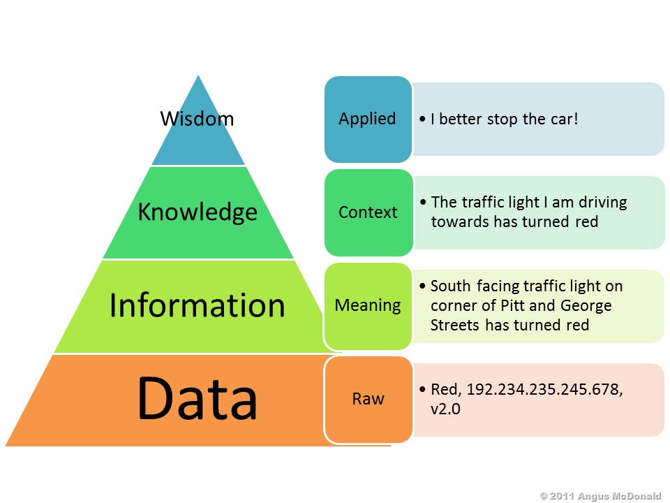
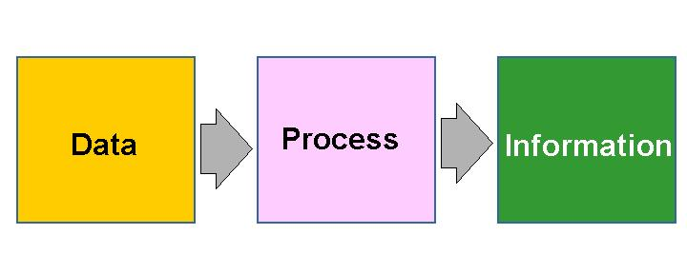
Data & Information

Slide 5
Data & Information
Data: It is raw, unorganized facts that need to be processed. Data can be something simple and seemingly random and useless until it is organized. Example: Each student's test score is one piece of data.
Information: When data is processed, organized, structured or presented in a given context so as to make it useful, it is called information.
Example: The average score of a class or of the entire school is information that can be derived from the given data.

Slide 6
Why Study Databases?
Databases are useful
  Many computing applications deal with large amounts of information
  Database systems give a set of tools for storing, searching and managing this information
Databases in CS
  Databases are a ‘core topic’ in computer science
  Basic concepts and skills with database systems are part of the skill set you will be assumed to have as a CS graduate

Slide 7
What is a Database?
“A set of information held in a computer”
      Oxford English Dictionary
“One or more large structured sets of persistent data, usually associated with software to update and query the data”
      Free On-Line Dictionary of Computing
“A collection of data arranged for ease and speed of search and retrieval”
      Dictionary.com

Slide 8
Database Systems
A database system consists of
  Data (the database)
  Software
  Hardware
  Users
We focus mainly on the software
Database systems allow users to
  Store
  Update
  Retrieve
  Organise
  Protect
their data.

Slide 9
Database Management Systems
A database is a collection of information
A database management system (DBMS) is the software than controls that information
Examples:
  Oracle
  DB2 (IBM)
  MS SQL Server
  MS Access
  Ingres
  PostgreSQL
  MySQL

Slide 10
Database Users
End users
  Use the database system to achieve some goal
Application developers
  Write software to allow end users to interface with the database system
Database Administrator (DBA)
  Designs & manages the database system
Database systems programmer
  Writes the database software itself

Slide 11
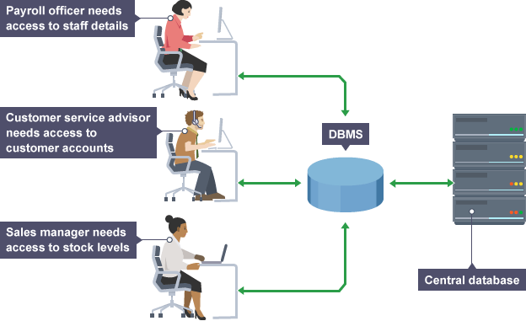
Database Management System (DBMS)

Slide 12

Advantages of Database Approach
Library
Examination
Registration
Library
Applications
Examination
Applications
Registration
Applications
Database
Management
System
University
Students
Database
- Data Sharing
- Data Independence
- Controlled Redundancy
- Better Data Integrity

Slide 13
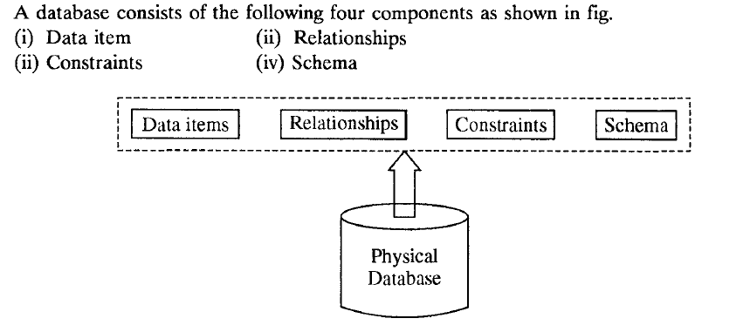

Slide 14
Database Management System (DBMS)
Database Applications:
  Banking: transactions
  Airlines: reservations, schedules
  Universities: registration, grades
  Sales: customers, products, purchases
  Online retailers: order tracking, customized recommendations
  Manufacturing: production, inventory, orders, supply chain
  Human resources: employee records, salaries, tax deductions
Databases can be very large.
Databases touch all aspects of our lives.

Slide 15
Functions and Services of DBMS
Data Storage Management:
Transaction Management:
Integrity Services:
Backup and Recovery Management:
Concurrency Control Services:
Data Manipulation Management:
Data Dictionary/System Catalog Management:
Authorization/Security Management :
Utility Services:
Database Access and Application Programming Interfaces :

Slide 16
File Processing System
A collection of application programs that perform services for the end-users such as production of reports
Each program defines and manages its own data

Slide 17
File Processing Systems
Library
Examination
Registration
Library
Applications
Examination
Applications
Registration
Applications
Library
Data
Files
Examination
Data
Files
Registration
Data
Files
Program and Data Interdependence

Slide 18
File Processing Systems
Library
Examination
Registration
Reg_Number
Reg_Number
Reg_Number
Name
Name
Name
Father Name
Address
Father Name
Books Issued
Class
Phone
Fine
Semester
Address
Grade
Class

Slide 19
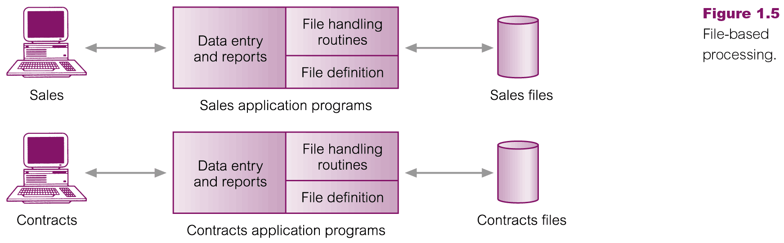
Files Based Processing

Slide 20
Disadvantages of File Processing
Program-Data Dependence
  File structure is defined in the program code.
  All programs maintain metadata for each file they use
Duplication of Data (Data Redundancy)
  Different systems/programs have separate copies of the same data
  Same data is held by different programs.
  Wasted space and potentially different values and/or different formats for the same item.
Limited Data Sharing
  No centralized control of data
  Programs are written in different languages, and so cannot easily access each other’s files.

Slide 21
Exercise: Sample Question
What is data and information? Explain with example.
Briefly discuss the application of database management system (DBMS).
What are RDBMS and DBMS? List four significant differences between a file processing system and a DBMS.

